Slide 1









Whiteboardmaths.com
7
2
1
5
© 2004 All rights reserved

Slide 2

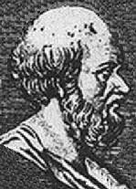
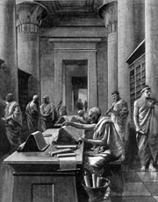
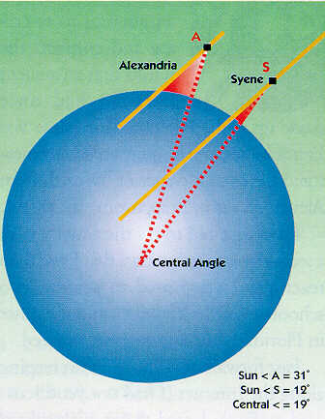
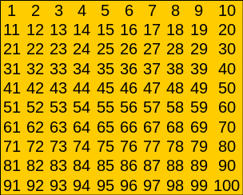
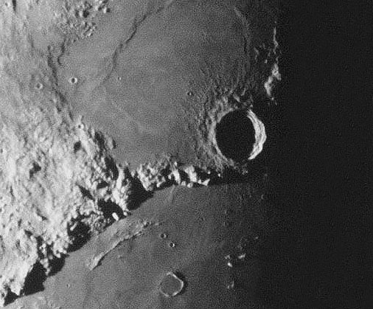
Eratosthenes of Cyrene (275-194 B.C)
Eratosthenes was a prominent Greek scholar who spent his early life in Athens. He was a friend and contemporary of Archimedes and excelled in many areas, notably mathematics, astronomy, geography, history, poetry and athletics. He was a universal genius who was known to his friends as Beta, because he was regarded as the second best in almost all the fields he studied. He eventually went to Alexandria (Egypt) where he became the 3rd librarian at the great university as well as private tutor to the son of Ptolemy III. It was Eratosthenes who suggested a calendar (later adopted by the Romans) of 365 days with an additional day every 4th year. During old age he went blind and ended his life by drinking poison.
He is best remembered today for two notable achievements:
The use of his “Sieve” to isolate prime numbers
His ingenious method for determining the distance around the Earth with a high degree of accuracy.

Slide 3
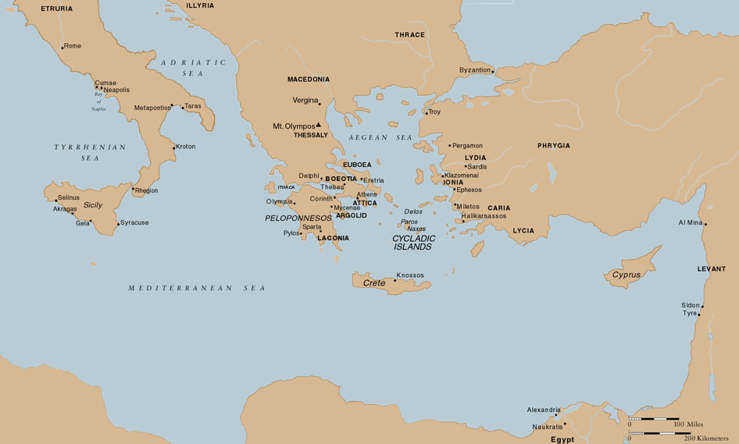
The Greek World around 450 BC
Troy
Athens
Alexandria
This is the Golden Age of Athens, the time of Pericles and Socrates. Very few ordinary citizens would have travelled outside this area.

Slide 4

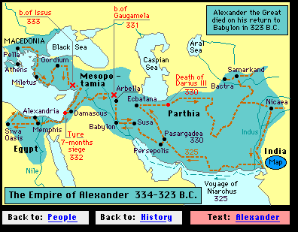

The Decline of Athens, the Rise of Alexandria.
By 300 BC Alexandria had eclipsed Athens, both as a merchant power and a centre of culture.

Slide 5
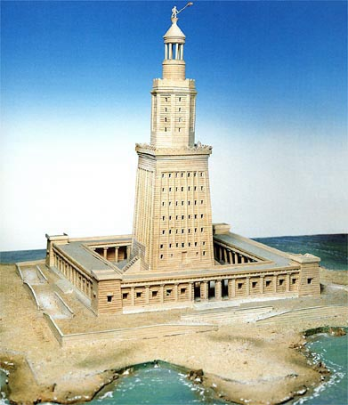
The library of Alexandria was the foremost seat of learning in the world and functioned like a university. The library contained 600 000 manuscripts.
The Lighthouse (Pharos) of Alexandria, built under Ptolemy after the death of Alexander. This is one of the 7 ancient wonders of the world. It stood at 117m (384 feet in height). It was finally destroyed by the earth quakes of 1303 and 1323.

Slide 6
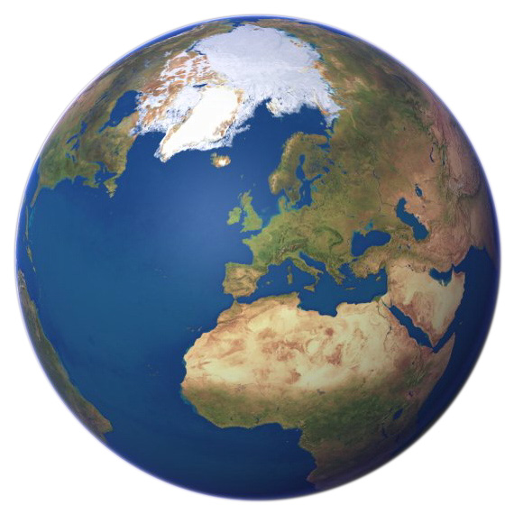

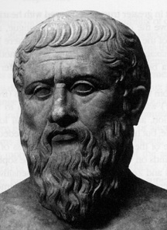

Earth Measure
The idea of a spherical Earth was well established in Greek culture.
500 BC: Pythagoras proposes a spherical Earth on purely aesthetic grounds. The Pythagorean’s believed the sphere to be the most perfect shape.
400 BC: Plato espouses the same idea in his dialogue (Phaedo) which receives wider circulation.
Aristotle (384 - 322 BC): Aristotle proposes a spherical Earth on geometric and symmetrical grounds but backed up by observational evidence.
Eratosthenes (275 – 194 BC): Decides to calculate the Earth’s circumference based on his knowledge of Geography coupled with a mathematical Theorem from Euclid’s work “The Elements”. His method was based on first hand knowledge of a town, (Syene) that lay approximately 500 miles south of Alexandria.

Slide 7
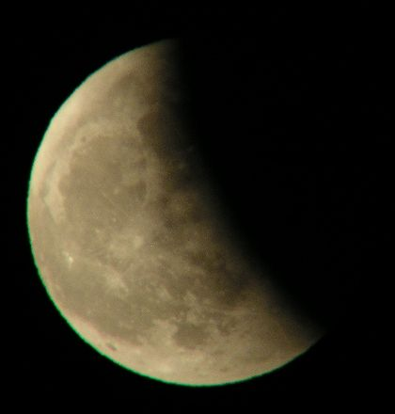
Observational evidence for a Spherical Earth
Projection of Earth’s shadow onto the surface of the moon shows curvature.
Lunar Eclipse

Slide 8

Observational evidence for a Spherical Earth
The “sinking” appearance of a departing ship relative to the observer’s horizon.
Bottom of ship disappears.

Slide 9
Whereas on a flat Earth
All of the ship would remain visible as apparent size diminishes.

Slide 10
Positioning on the Earth’s Surface
To appreciate his method more fully, an understanding of latitude and longitude is useful. With that in mind:

Slide 11


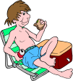

Positioning on the Earth’s Surface
East is the direction of rotation of the Earth
Latitude: (90ºN to 90ºS)
North Pole
Greenwich Meridian
0º Longitude
(Cleethorpes)
Longitude: (180ºE to 180ºW)
Grimsby: Latitude 53½º North
Alexandria
Tropic of Cancer
Syene
Latitude 23½º North
21st June
90ºE
53½º
60ºE
30ºW
30ºE
60ºW
90ºW
23½º
22nd Sept
20th March
90º
Equator
23½º
Latitude 0º
90⁰
22nd December
Tropic of Capricorn
Latitude 23½º South
Longitude 90º West
Longitude 90ºEast
Longitude 60º West
Longitude 60º East
Longitude 30º West
Longitude 30º East
South Pole
Latitude and Longitude together enable the fixing of position on the Earth’s surface.

Slide 12



The Method of Eratosthenes
1
Eratosthenes knew that Syene marked the Northern most point of the migration of the Sun and that this occurred each year at noon on the 21st of June. In today’s terms, it is located on the Tropic of Cancer (23½º N of the equator).
Alexandria
21st June
Syene
2
He knew this because the water at the bottom of a local well only became visible at noon on this day. A local vertical placed at Syene at this time would cast no shadow, as the sun is directly overhead. He made the important assumption that rays of light arriving from a distance sun would be parallel to each other.
Sun overhead at Syene. on midsummer's day.
North
Shadows at noon.
No shadows at noon.
500 miles
3
stick
He calculated that Alexandria was approximately 500 miles north of Syene, which puts it roughly on the same line of longitude. (30º E of Greenwich). Places on the same line of longitude experience time at the same time. In particular, noon at both places occurs at the same instant. A local vertical placed at Alexandria would cast a shadow at noon.
Syene
(Aswan)
Alexandria
well

Slide 13
The Method of Eratosthenes
Not to scale (would you believe)
Measurements are approximate.
Alexandria
21st June
Syene
Parallel rays of light at noon
stick
North
α
Syene
Local vertical
Sun overhead Syene. at noon on midsummer's day.
no shadows water visible!
500 miles
Shadow line of stick on ground is of minimum length at noon.
Local vertical
Alexandria
Angle
Distance
well
7½º
500 miles
Eratosthenes measured angle α as approximately 7½º
?
15º
1000 miles
7½º
Alternate angles are equal.
30º
2000 miles
α
Can you figure out what he did and arrive at an estimate for the circumference of the Earth?
60º
4000 miles
360º
24000 miles
4%
Taking the true value as 25,000 miles, find his percentage error.

Slide 14
The Story of Longitude.
John Harrison Barrow-on-Humber

Slide 15
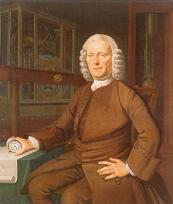
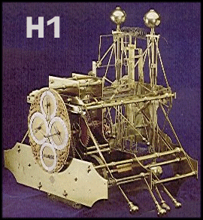
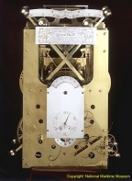
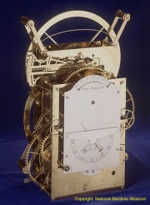
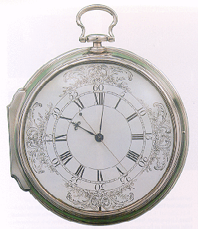
John Harrison (1693 – 1776): Barrow – on - Humber
H1:1737
H2:1741
H3:1759
H4:1760
Anyone alive in the 18th century would have known that the “longitude problem” was the thorniest scientific dilemma of the day - and had been for centuries. Lacking the ability to measure their longitude, sailors throughout the great ages of exploration had been literally lost at sea as soon as they lost sight of land. Thousands of lives and the fortunes of nations, hung on a resolution.
The quest for a solution had occupied scientists and their patrons for the better part of two centuries, when in 1714, Parliament upped the ante by offering a King’s ransom (£20,000) to anyone whose method or device proved successful. Countless quacks weighed in with preposterous suggestions.
The scientific establishment throughout Europe – from Galileo to Isaac Newton – had mapped the heavens in both hemispheres in its certain pursuit of a celestial answer. In stark contrast, one man, John Harrison dared to imagine a mechanical solution – a clock that would keep precise time at sea, something no clock had ever been able to do on land. Longitude is a dramatic human story of an epic scientific quest and of Harrison’s forty – year obsession with building his perfect time keeper.
Dava Sobel

Slide 16
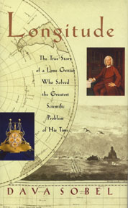
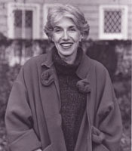
“Dava Sobel has written a gem of a book. Longitude is one of the best reads for the non-scientific mind to come along in many a moon”.
Financial Times
“A wonderful story, beautifully told….Sobel has has done the impossible and made horology sexy”
New Scientist
“Sobel has a remarkable ability to tell a story with clarity and perfect pacing… a gem of a book”.
New York Times

